Slide 1

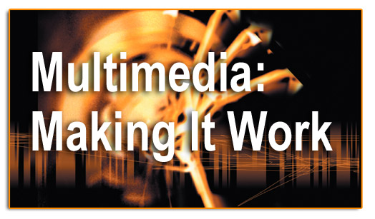
Sound

Slide 2
Objectives
Use sound in a multimedia project.
Use MIDI and understand its attributes, especially relative to digitized audio.
Calculate sampling sizes and considerations for digitized sound.
Record, process, and edit digital audio.
Determine which audio file formats are best for use in multimedia projects.
Manage audio files and integrate them into multimedia projects.

Slide 3
Overview
Introduction to sound.
Multimedia system sound.
Digital audio.
MIDI audio.
Audio file formats.
MIDI versus digital audio.
Adding sound to multimedia project.
Production tips.

Slide 4
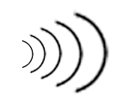
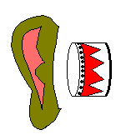
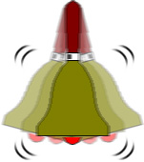
Introduction to Sound
Vibrations in the air create waves of pressure that are perceived as sound.
Sound comprises the spoken word, voices, music and even noise.
Sound waves vary in sound pressure level (amplitude) and in frequency or pitch.
‘Acoustics’ is the branch of physics that studies sound.
Sound pressure levels (loudness or volume) are measured in decibels (dB).
Something vibrates
in the air
Ear drums will translate
these changes in wave
Forms as sound
Waves of pressure

Slide 5
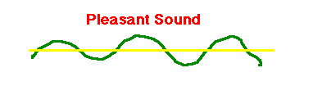
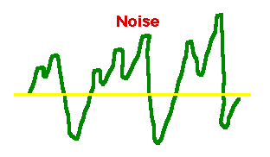
Introduction to Sound
A pleasant sound has a regular wave pattern. The pattern is repeated over and over.
But the waves of noise are irregular. They do not have a repeated pattern.

Slide 6
Multimedia System Sound
System sounds are assigned to various system events such as startup and warnings, among others.
In Windows, available system sounds include start.wav, chimes.wav, and chord.wav.
Multimedia sound is either digitally recorded audio or MIDI (Musical Instrumental Digital Interface) music.

Slide 7
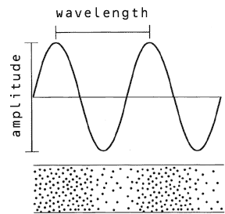
Characteristic of Sound Waves
Sound is described in terms of two characteristics:
  Frequency (or pitch)
  Amplitude (or loudness)

Slide 8
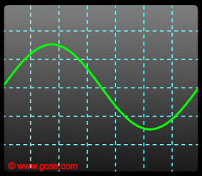
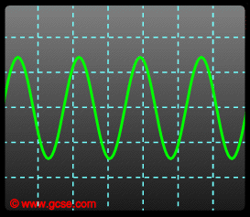
Frequency
Frequency is a measure of how many cycles occur in one second. This is measured in Hertz (abbreviation Hz) and directly corresponds to the pitch of a sound.
  The more frequent vibration occurs the higher the pitch of the sound.
Low pitch
High pitch
Optimally, people can hear from 20 Hz to 20,000 Hz (20 kHz)
  Sounds below 20 Hz are infrasonic
  sounds above 20 kHz are ultrasonic.

Slide 9
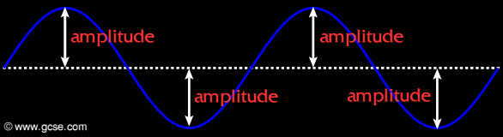
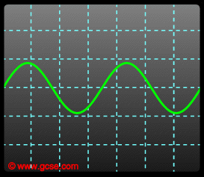
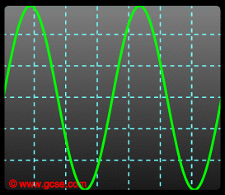
Amplitude
Amplitude is the maximum displacement of a wave from an equilibrium position.
  The louder a sound, the more energy it has. This means loud sounds have a large amplitude.
Quiet
Loud
Low amplitude
High Amplitude
  The amplitude relates to how loud a sound is.

Slide 10
Characteristic of Sound Waves
Time for one cycle
Amplitude
wavelength
distance
along wave
Cycle

Slide 11
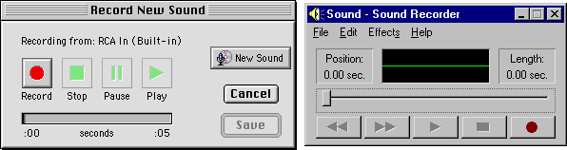
Audio Recording Software
MACINTOSH WINDOWS
Sound Recorders for Windows
  Both Macintosh and Windows PC platform have the default sound.
  This basic application could:
    Record our own sounds
    Edit & mix *.wav files
    Increase volume & speed of *.wav files
    Reverse the sound.
    Add Echo effects
    Some XP Version also provide wav to mp3 conversion.

Slide 12
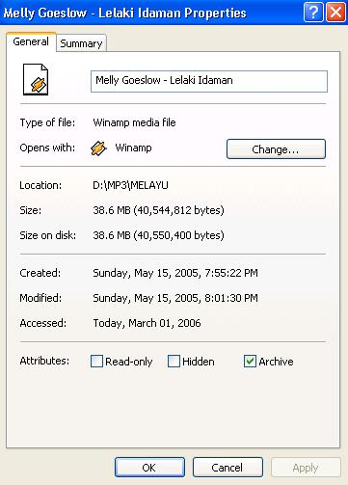
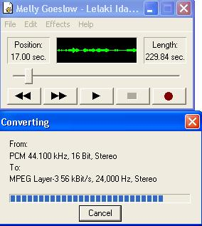
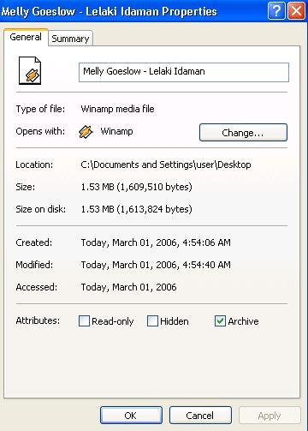
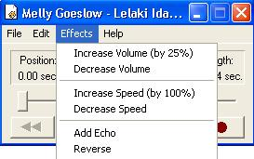
Basic Sound Recorder
Sound conversion
Basic Effects

Slide 13

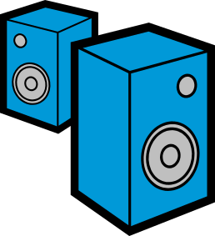
Capture & Playback of Digital Audio
Air pressure
variations
Digital to
Analogue
Converter
Converts back into voltage
DAC
Captured via
microphone
Signal is
converted into
binary
(discrete form)
0101001101
0110101111
Analogue
to Digital
Converter
ADC
Air pressure
variations

Slide 14
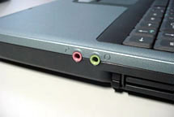
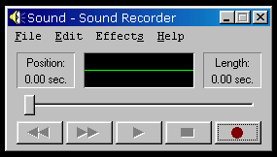
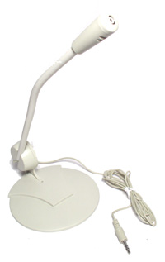
Recording Audio Files
Recording Audio Files on the pc
  Uses either:
  Microphone
    connect microphone to the microphone port and record using sound recorder

Slide 15
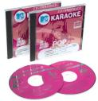
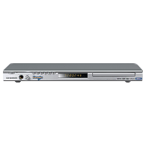
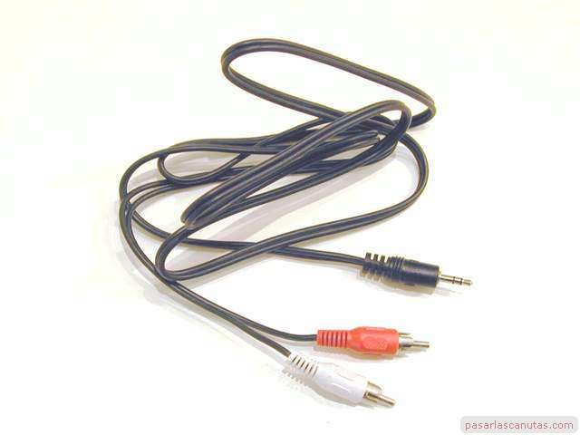
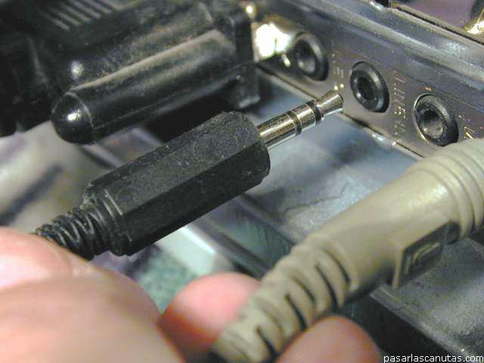
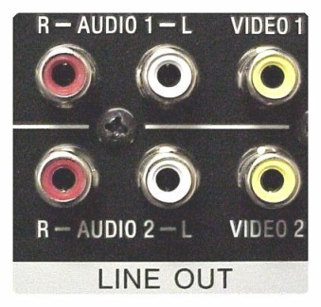
Recording Audio Files
CD-ROM Drive
  Move music files from CD to hard drive or;
  Play the cd and then record using the sound recorder.
Line-in
  pressing play on the audio source, which is connected to the computer’s audio line-in socket. Record using the sound recorder.
Line in port on the pc
Audio cable

Slide 16
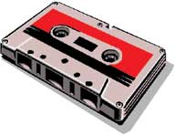
Analog to Digital Audio
Analog audio
The name for an electronic signal that carries its information of sound as continuous fluctuating voltage value.
Stored in non digital tape or audio tape recording of sound.
Digitizing
the process of converting an analog signal to a digital one.
A sound is recorded by making a measurement of the amplitude of the sound at regular intervals which are defined by the "sampling rate“ (frequent of sample point taken).
The process of taking the measurement is called "sampling" and each measurement is called a "sample point".

Slide 17
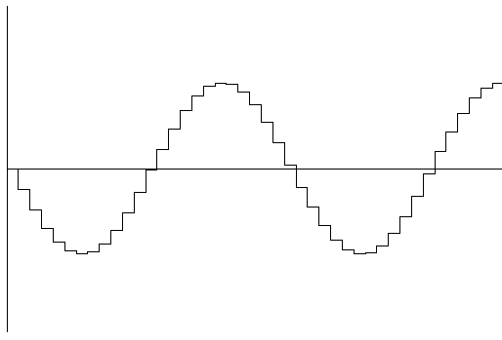
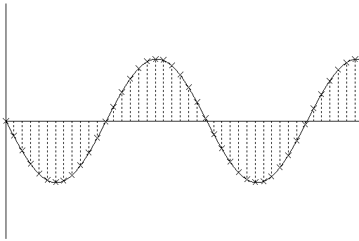
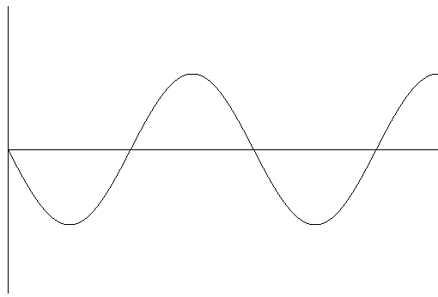
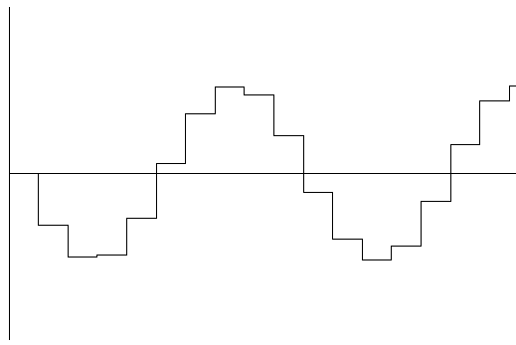
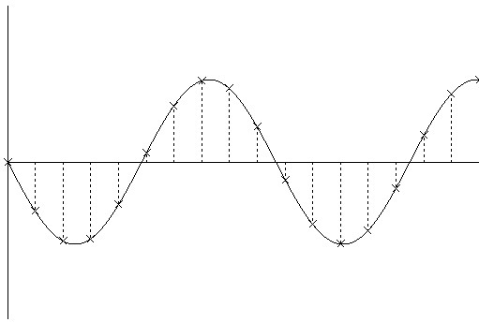
Digital Audio
Digital audio - data are stored in the form of samples point.
Samples represent the amplitude (or loudness) of sound at a discrete point in time.
Quality of digital recording depends on the sampling rate, the number of samples point taken per second (Hz).
High Sampling Rate
Samples stored in digital form
waveform
Low Sampling Rate

Slide 18
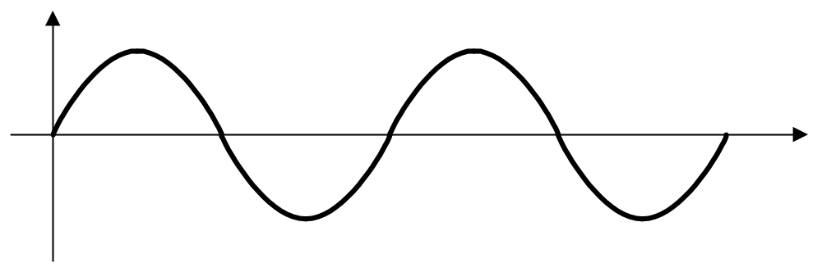
Digital Sampling
1 second

Slide 19
Digital Sampling

Slide 20
Digital Audio
There are three sampling frequencies most often used in multimedia are 44.1 kHz, 22.05 kHz and 11.025 kHz.
  The higher the sampling rate, the more the measurements are taken (better quality).
  The lower the sampling rate, the lesser the measurements are taken (low quality).
The number of bits used to describe the amplitude of sound wave when sampled, determines the sample size.
High Sampling Rate
Low Sampling Rate

Slide 21
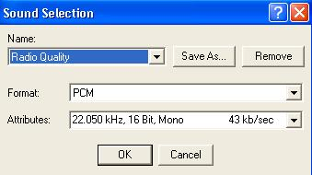
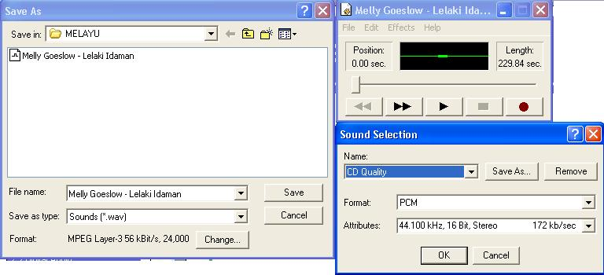
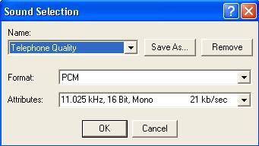
Digital Audio
Quality factors for digital audio file :
  Sampling Rate
  Sample Size (resolution)
    the number of bits used to record the value of a sample in a digitized signal.
Sampling Rate
Sample size

Slide 22
Digital Audio
Other than that, it also depends on:
  The quality of original audio source.
  The quality of capture device & supporting hardware.
  The characteristics used for capture.
  The capability of the playback environment.

Slide 23
Digital Audio
Crucial aspects of preparing digital audio files are:
  Balancing the need for sound quality against available RAM and hard disk resource.
  Setting appropriate recording levels to get a high-quality and clean recording.

Slide 24
Digital Audio
Audio resolution determines the accuracy with which sound can be digitized.
Size of a monophonic digital recording = sampling rate x duration of recording in seconds x (bit resolution/8) x 1.
Size of stereo recording = sampling rate x duration of recording in seconds x (bit resolution/8) x 2.

Slide 25
Digital Audio
Once a recording had been completed, it almost always needs to be edited.
Basic sound editing operations include trimming, splicing and assembly, volume adjustments and working on multiple tracks.
Additional available sound editing operations include format conversion, resampling or downsampling, fade-ins and fade-outs, equalization, time stretching, digital signal processing, and reversing sounds.

Slide 26
Quantization
The digitization of analog signals involves the rounding off of the values which are approximately equal to the analog values. The method of sampling chooses a few points on the analog signal and then these points are joined to round off the value to a near stabilized value. Such a process is called as Quantization.

Slide 27
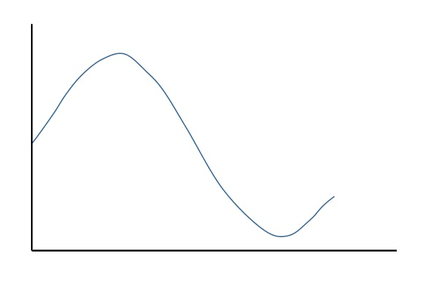
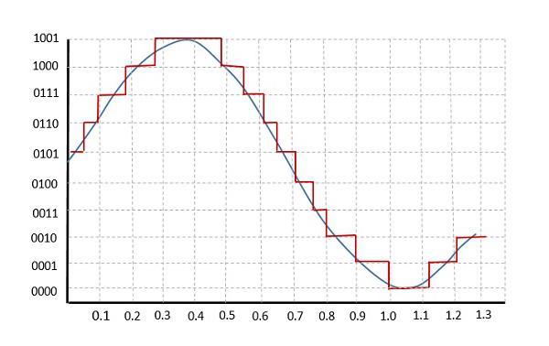
Fig: Original and Quantized Waveform

Slide 28
Clipping
Clipping is a form of distortion that limits a signal once it exceeds a threshold. Clipping may occur when a signal is recorded by a sensor that has constraints on the range of data it can measure, it can occur when a signal is digitized, or it can occur any other time an analog or digital signal is transformed, particularly in the presence of gain or overshoot and undershoot.

Slide 29
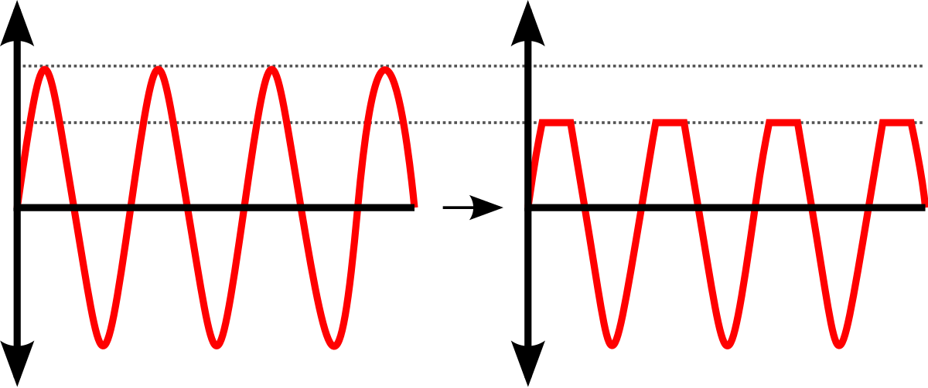
Fig: Original and clipped waveform

Slide 30
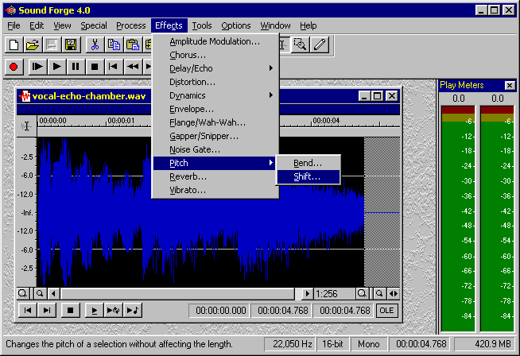
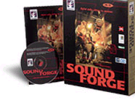
Digital Audio - Software
More advanced Digital audio editing software:
  One of the most powerful and professional PC-based packages is a tool called Sound Forge
  http://www.sonicfoundry.com/
Others audio editing software:
  COOL Edit Pro
  Gold Wave
  PROSONIQ SonicWORX
  Samplitude Studio

Slide 31
Editing Digital Recordings
The basic sound editing operations that most multimedia producers need are as follows:
Multiple Tracks
Trimming
Splicing and Assembly
Volume Adjustments
Format Conversion
Resampling or Down sampling
Fade-ins and Fade-outs
Equalization
Time Stretching
Digital Signal Processing

Slide 32
1. Multiple Tracks
Being able to edit and combine multiple tracks and then merge the tracks and export them in a “final mix” to a single audio file.

Slide 33
2. Trimming
Removing “dead air” or blank space from the front of a recording and any unnecessary extra time off the end is your first sound editing task. Trimming is typically accomplished by dragging the mouse cursor over a graphic representation of your recording and choosing a menu command such as Cut, Clear, Erase, or Silence.

Slide 34
3. Splicing and Assembly
Remove the extraneous noises that inevitably creep into a recording using the same tools used for trimming. There may be need to assemble longer recordings by cutting and pasting together many shorter ones.

Slide 35
4. Volume Adjustments
To provide a consistent volume level, select all the data in the file, and raise or lower the overall volume by a certain amount when assembled many different recordings into a single track.

Slide 36
5. Format Conversion
Most sound editing software will save files in your choice of many formats, most of which can be read and imported by multimedia authoring systems.

Slide 37
6. Resampling or Down sampling
If you have recorded and edited your sounds at 16-bit sampling rates but are using lower rates and resolutions in your project, you must resample or down sample the file. Your software will examine the existing digital recording, and work through it to reduce the number of samples.

Slide 38
7. Fade-ins and Fade-outs
Most programs offer enveloping capability, useful for long sections that you wish to fade in or fade out gradually. This enveloping helps to smooth out the very beginning and the very end of a sound file.

Slide 39
8. Equalization
Some programs offer digital equalization capabilities that allow you to modify a recording’s frequency content so that it sounds brighter or darker.

Slide 40
9. Time Stretching
Advanced programs let you alter the length (in time) of a sound file without changing its pitch.

Slide 41
10. Digital Signal Processing (DSP)
Some programs allow you to process the signal with reverberation, multitap delay, chorus, flange, and other special effects using DSP routines.

Slide 42
11. Reversing Sound
Sounds, particularly spoken dialogue, can produce a surreal, otherworldly effect when played backward.

Slide 43
What is MIDI?
MIDI stands for Musical Instrument Digital Interface
Some Clarification:
MIDI doesn’t directly describe musical sound
MIDI is not a language
It is a data communications protocol
The MIDI protocol — lets synthesizers, computers and other devices talk to each other.

Slide 44
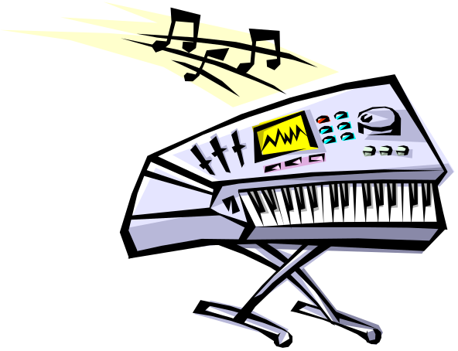

What is MIDI?
audio
m e s s a g e s
Messages use MIDI cables.
Audio uses audio cables.

Slide 45
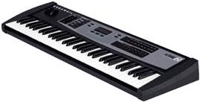
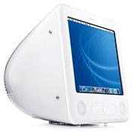
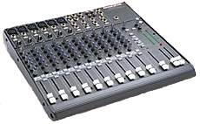
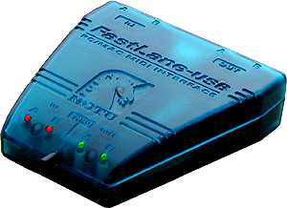
What is MIDI?
IN
OUT
IN
OUT
Audio
MIDI
USB

Slide 46
MIDI Benefits
it represents musical data in an extremely efficient way, leading to drastic reductions in file sizes compared to sampled audio. For instance, files containing high quality stereo sampled audio require about 10 Mb per minute of sound, while a typical MIDI sequence may need less than 10 Kb.
The secret to this phenomenal size reduction is that a MIDI sequence stores 'instructions' for playing the music rather than the music itself. A simple analogy is that a sequence is the written score for a piece of music rather than a recording of it.
The drawback is that the sequence must be converted to audio output at run-time. This is achieved using a sequencer and synthesizer.

Slide 47
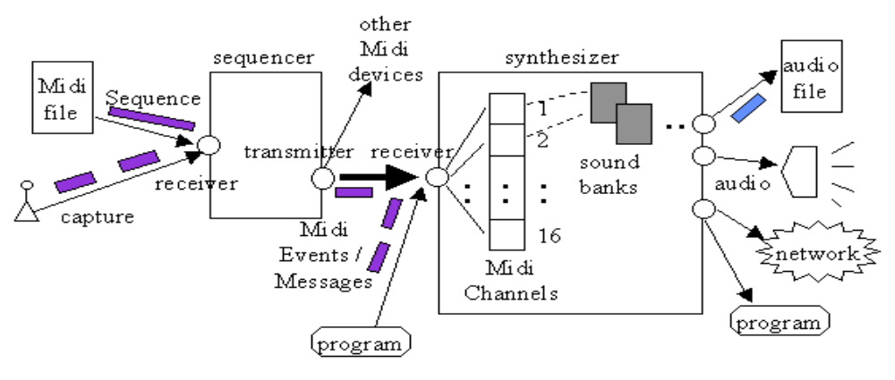
MIDI Configuration
A MIDI sequencer allows MIDI data sequences to be captured, stored, edited, combined, and performed, while the MIDI data's transformation into audio is carried out by the synthesizer.

Slide 48
MIDI Ports
Serial transfer, data are sent bit by bit
Hence:
- transmission rate is slow at only 31,250 bits/sec.
-Too slow to transmit samples in real-time
- have to do off-line sample dump

Slide 49
MIDI Interface
MIDI In
MIDI data enters each item of MIDI equipment through the MIDI In port.
MIDI Out
All the MIDI data generated by individual pieces of equipment are sent out through the MIDI Out port.
→A common error for MIDI setup is: inverted connection of MIDI IN/OUT
MIDI Thru
These are used to re-transmit all information received at the MIDI In port using the MIDI Thru port connections.
Often these ports are used to create a chain of connected devices in a single MIDI data path, called a 'daisy chain'.

Slide 50
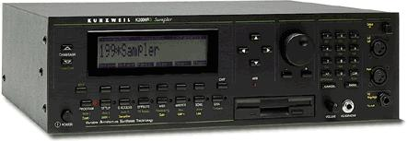
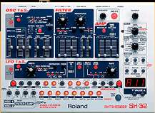
Connecting Devices Using MIDI Thru
IN
OUT
IN
IN
THRU
THRU
THRU port transmits copy of messages from IN port
The 3 devices must share 16 channels

Slide 51
Limitations of MIDI
1. Slow -- Serial transfer
When there have too much continuous data transfer (e.g. a lot of control data)→ MIDI choke
  Solution: can be solved by EVENT FILTERING
  e.g., discard less important messages (esp., system exclusive messages)

Slide 52
Limitations of MIDI
2. Slow -- MIDI is only control information, and time is needed to synthesize the sound
computation time → MIDI lag
  Solution: users have to avoid using patch (instrument) which uses a lot of memory

Slide 53
Limitations of MIDI
3. Sound quality varies
It depends on which synthesizer you use
  Solution:
  users have to judge by ear, to see which sound is good
  Standardized with General MIDI (GM) (discussed later)

Slide 54
Limitations of MIDI
3. Sound quality varies
the size of MIDI file is very small!
  e.g. :
  a three minutes wav file, 48kHz, stereo:
    size of 40MB
  a three minutes MIDI file, with 10 channels:
    size of 40kb
It is because MIDI file doesn’t actually contain audio data, but only control information (like Csound score)

Slide 55
Structure
Structure of MIDI messages:
MIDI message includes a status byte and up to two data bytes.
Status byte
  The most significant bit of status byte is set to 1.
  The 4 low-order bits identify which channel it belongs to (four bits produce 16 possible channels).
  The 3 remaining bits identify the message.
The most significant bit of data byte is set to 0.

Slide 56
MIDI Versus Digital Audio
MIDI is analogous to structured or vector graphics, while digitized audio is analogous to bitmapped images.
MIDI is device dependent while digitized audio is device independent.
MIDI files are much smaller than digitized audio.
MIDI files sound better than digital audio files when played on a high-quality MIDI device.

Slide 57
MIDI Versus Digital Audio
With MIDI, it is difficult to playback spoken dialog, while digitized audio can do so with ease.
MIDI does not have consistent playback quality while digital audio provides consistent playback quality.
One requires knowledge of music theory in order to run MIDI, while digital audio does not have this requirement.

